Slide 1
UNIT 3 QUERY PROCESSING
SQL Queries - Embedded SQL - MySQL: Basics, Queries in MySQL and Algorithms for Query Processing and Optimization – Introduction to Transaction Processing Concepts and Theory - Concurrency control techniques.

Slide 2
SQL – AN INTRODUCTION
SQL is an ANSI standard computer language for accessing and manipulating databases.
The databases covered are: Oracle, DB2, Sybase, Informix, Microsoft SQL Server, Microsoft Access, and other database systems.
Like QBE, SQL provides users with a way of querying relational databases.
SQL was developed under the name SEQUEL at the IBM San Jose research center in the mid 1970s.
In 1980, it was renamed SQL (still pronounced as “Sequel”) to avoid confusion with an unrelated hardware product also called SEQUEL.

Slide 3
WHAT IS SQL?
SQL stands for Structured Query Language
SQL allows you to access a database
SQL is an ANSI standard computer language
SQL can execute queries against a database
SQL can retrieve data from a database
SQL can insert new records in a database
SQL can delete records from a database
SQL can update records in a database
SQL is easy to learn

Slide 4
SQL LANGUAGES
Data Definition Language(DDL) – Consists of commands which are used to define the database.
Data Manipulation Language(DML) – Consists of commands which are used to manipulate the data present in the database.
Data Control Language(DCL) – Consists of commands which deal with the user permissions and controls of the database system.
Transaction Control Language(TCL) – Consist of commands which deal with the transaction of the database.

Slide 5
DATABASE EXAMPLE
Employee ID | Employee Name | Emergency Contact Name | Phone Number | Address | City | Country
01 | Shanaya | Abhinay | 9898765612 | Oberoi Street 23 | Mumbai | India
02 | Anay | Soumya | 9432156783 | Marathalli House No 23 | Delhi | India
03 | Preeti | Rohan | 9764234519 | Queens Road 45 | Bangalore | India
04 | Vihaan | Akriti | 9966442211 | Brigade Road Block 4 | Hyderabad | India
05 | Manasa | Shourya | 9543176246 | Mayo Road 23 | Kolkata | India

Slide 6
SQL Commands:
Data Definition Language Commands (DDL)
CREATE
DROP
TRUNCATE
ALTER
BACKUP DATABASE

Slide 7
CREATE COMMAND
CREATE USER
CREATE USER username
Example
CREATE USER maran;
GRANT PERMISSION TO THE USERR
GRANT ALL TO maran;
(From root granting DDL,DML commands to user)

Slide 8
CREATE COMMAND
CREATE TABLE
This statement is used to create a table.
Syntax
CREATE TABLE TableName ( Column1 datatype, Column2 datatype, Column3 datatype, .... ColumnN datatype );
Example
CREATE TABLE Employee_Info
(EmployeeID int, EmployeeName varchar(255),
EmergencyContactName varchar(255), PhoneNumber int,
Address varchar(255), City varchar(255), Country varchar(255));

Slide 9
CREATE COMMAND
CREATE TABLE using another TABLE
Example
CREATE TABLE ExampleTable AS
SELECT EmployeeName, PhoneNumber
FROM Employee_Info;

Slide 10
DROP COMMAND
DROP
This statement is used to drop (delete) an existing table or a database with data.
Syntax
DROP DATABASE Database Name;
Example
DROP DATABASE Employee;
Syntax
DROP TABLE Table Name;
Example
DROP Table Employee_Info

Slide 11
TRUNCATE COMMAND
TRUNCATE
This command is used to delete the information(records) present in the table but does not delete the table. So, once you use this command, your information will be lost, but not the table.
Syntax
TRUNCATE TABLE TableName;
Example
1TRUNCATE Table Employee_Info

Slide 12
ALTER COMMAND
ALTER
This command is used to delete, modify or add constraints or columns in an existing table.
The ‘ALTER TABLE’ Statement with ADD/DROP COLUMN
Syntax
ALTER TABLE TableName ADD ColumnName Datatype; ALTER TABLE TableName DROP COLUMN ColumnName;
Example
ADD Column BloodGroup:
ALTER TABLE Employee_Info ADD BloodGroup varchar(255);
DROP Column BloodGroup:
ALTER TABLE Employee_Info DROP COLUMN BloodGroup ;

Slide 13
ALTER COMMAND
The ‘ALTER TABLE’ Statement with ALTER/MODIFY COLUMN
This statement is used to change the datatype of an existing column in a table.
Syntax
ALTER TABLE TableName ALTER COLUMN ColumnName Datatype;
Example
Add a column DOB and change the data type to Date.
ALTER TABLE Employee_Info ADD DOB year;
ALTER TABLE Employee_Info ALTER DOB date;

Slide 14
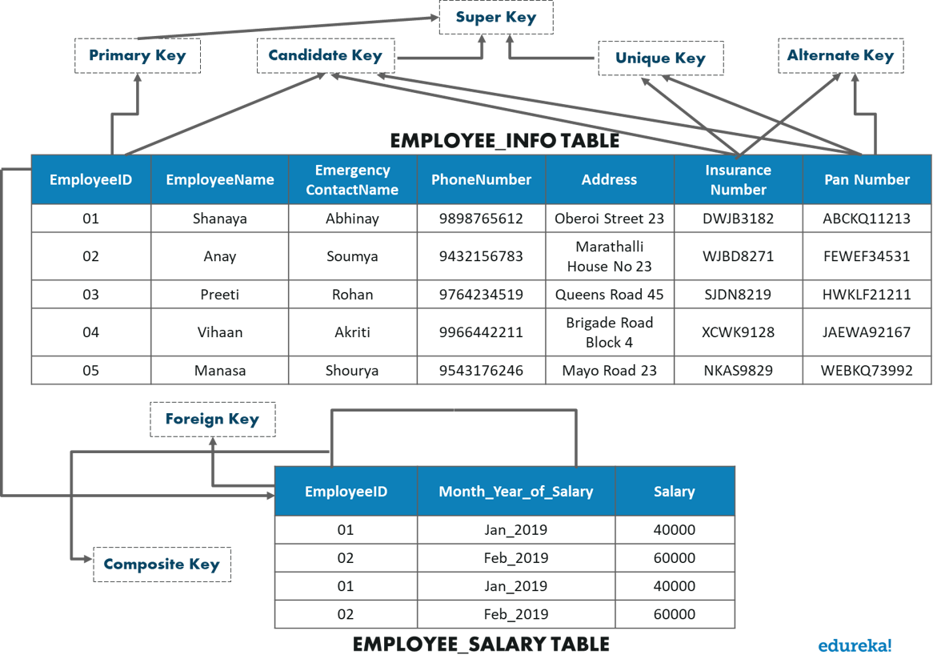
SQL Commands: Different Types Of Keys In Database

Slide 15
There are mainly 7 types of Keys, that can be considered in a database.
Candidate Key – A set of attributes which can uniquely identify a table can be termed as a Candidate Key. A table can have more than one candidate key, and out of the chosen candidate keys, one key can be chosen as a Primary Key. In the above example, since EmployeeID, InsuranceNumber and PanNumber can uniquely identify every tuple, they would be considered as a Candidate Key.
Super Key – The set of attributes which can uniquely identify a tuple is known as Super Key. So, a candidate key, primary key, and a unique key is a superkey, but vice-versa isn’t true.
Primary Key – A set of attributes which are used to uniquely identify every tuple is also a primary key. In the above example, since EmployeeID, InsuranceNumber and PanNumber are candidate keys, any one of them can be chosen as a Primary Key. Here EmployeeID is chosen as the primary key.
Alternate Key – Alternate Keys are the candidate keys, which are not chosen as a Primary key. From the above example, the alternate keys are PanNumber and Insurance Number.
Unique Key – The unique key is similar to the primary key, but allows one NULL value in the column. Here the Insurance Number and the Pan Number can be considered as unique keys.
Foreign Key – An attribute that can only take the values present as the values of some other attribute, is the foreign key to the attribute to which it refers. in the above example, the Employee_ID from the Employee_Information Table is referred to the Employee_ID from the Employee_Salary Table.
Composite Key – A composite key is a combination of two or more columns that identify each tuple uniquely. Here, the Employee_ID and Month-Year_Of_Salary can be grouped together to uniquely identify every tuple in the table.

Slide 16
SQL Commands: Constraints Used In Database
Constraints are used in a database to specify the rules for data in a table. The following are the different types of constraints:
NOT NULL
UNIQUE
CHECK
DEFAULT
INDEX

Slide 17
NOT NULL Constraints
This constraint ensures that a column cannot have a NULL value.
Example
CREATE TABLE Employee_Info(
EmployeeID int NOT NULL, EmployeeName varchar(255) NOT NULL,
Emergency ContactName varchar(255), PhoneNumber int NOT NULL,
Address varchar(255), City varchar(255), Country varchar(255));
-NOT NULL on ALTER TABLE
ALTER TABLE Employee_Info MODIFY PhoneNumber int NOT NULL;

Slide 18
UNIQUE Constraints
CREATE TABLE Employee_Info (
EmployeeID int NOT NULL UNIQUE,
City varchar(255), Country varchar(255));
UNIQUE on ALTER TABLE
ALTER TABLE Employee_Info ADD UNIQUE (Employee_ID);
To drop a UNIQUE constraint
ALTER TABLE Employee_Info DROP CONSTRAINT UC_Employee_Info;

Slide 19


Slide 20
SQL Commands:
Data Manipulation Language (DML)
The commands are as follows:
USE
INSERT INTO
UPDATE
DELETE
SELECT

Slide 21
USE
The USE statement is used to select the database on which you want to perform operations.
Syntax
USE DatabaseName;Example
USE Employee;

Slide 22
INSERT Command
INSERT INTO
This statement is used to insert new records into the table.
Syntax
INSERT INTO TableName (Column1, Column2, Column3, ...,ColumnN) VALUES (value1, value2, value3, ...);
Example
INSERT INTO Employee_Info(EmployeeID, EmployeeName, Emergency ContactName, PhoneNumber, Address, City, Country)
VALUES ('06', 'Sanjana','Jagannath', '9921321141', 'Camel Street House No 12', 'Chennai', 'India');
INSERT INTO Employee_Info VALUES ('07', 'Sayantini','Praveen', '9934567654', 'Nice Road 21', 'Pune', 'India');

Slide 23
UPDATE & DELETE Command
UPDATE
This statement is used to modify the records already present in the table.
Syntax
UPDATE TableName SET Column1 = Value1, Column2 = Value2, ... WHERE Condition;
Example
UPDATE Employee_Info SET EmployeeName = 'Aahana', City= 'Ahmedabad’ WHERE EmployeeID = 1;
DELETE
This statement is used to delete the existing records in a table.
Syntax
DELETE FROM TableName WHERE Condition;
Example
DELETE FROM Employee_Info WHERE EmployeeName='Preeti‘;

Slide 24
SELECT Command
SELECT
This statement is used to select data from a database and the data returned is stored in a result table, called the result-set.
Syntax
SELECT Column1, Column2, ...ColumN FROM TableName; --(*) is used to select all from the table SELECT * FROM table_name; -- To select the number of records to return use: SELECT TOP 3 * FROM TableName;
Example
SELECT EmployeeID, EmployeeName FROM Employee_Info;
(*) is used to select all from the table
SELECT * FROM Employee_Info;
To select the number of records to return use:
SELECT TOP 3 * FROM Employee_Info;

Slide 25
SELECT Command
Apart from just using the SELECT keyword individually, you can use the following keywords with the SELECT statement:
DISTINCT
ORDER BY
GROUP BY
HAVING Clause
INTO

Slide 26
SELECT DISTINCT Command
The ‘SELECT DISTINCT’ Statement
This statement is used to return only different values.
Syntax
SELECT DISTINCT Column1, Column2, ...ColumnN FROM TableName;
Example
SELECT DISTINCT PhoneNumber FROM Employee_Info;

Slide 27
SELECT ORDER BY Command
The ‘ORDER BY’ Statement
The ‘ORDER BY’ statement is used to sort the required results in ascending or descending order. The results are sorted in ascending order by default.
Yet, if you wish to get the required results in descending order, you have to use the DESC keyword.
Syntax
SELECT Column1, Column2, ...ColumnN FROM TableName ORDER BY Column1, Column2, ... ASC|DESC;
Example
Select all employees from the 'Employee_Info' table sorted by EmergencyContactName:
SELECT * FROM Employee_Info ORDER BY EmergencyContactName;

Slide 28
SELECT ORDER BY Command
Select all employees from the 'Employee_Info' table sorted by EmergencyContactName in Descending order:
SELECT * FROM Employee_Info ORDER BY EmergencyContactName DESC;
Select all employees from the 'Employee_Info' table sorted by EmergencyContactName and EmployeeName:
SELECT * FROM Employee_Info ORDER BY EmergencyContactName, EmployeeName;
SELECT * FROM Employee_Info ORDER BY EmergencyContactName ASC, EmployeeName DESC;

Slide 29
GROUP BY Command
The ‘GROUP BY’ Statement
This ‘GROUP BY’ statement is used with the aggregate functions to group the result-set by one or more columns.
Syntax
SELECT Column1, Column2,..., ColumnN FROM TableName WHERE Condition GROUP BY ColumnName(s) ORDER BY ColumnName(s);Example
To list the number of employees from each city.
SELECT COUNT(EmployeeID), City FROM Employee_Info
GROUP BY City;

Slide 30
HAVING Command
The ‘HAVING’ Clause
The ‘HAVING’ clause is used in SQL because the WHERE keyword cannot be used everywhere.
Syntax
SELECT ColumnName(s) FROM TableName WHERE Condition GROUP BY ColumnName(s) HAVING Condition ORDER BY ColumnName(s);
Example
To list the number of employees in each city. The employees should be sorted high to low and only those cities must be included who have more than 5 employees:
SELECT COUNT(EmployeeID), City FROM Employee_Info GROUP BY City
HAVING COUNT(EmployeeID) > 2 ORDER BY COUNT(EmployeeID) DESC;

Slide 31
SELECT INTO Command
The ‘SELECT INTO’ Statement
The ‘SELECT INTO’ statement is used to copy data from one table to another.
Syntax
SELECT * INTO NewTable [IN ExternalDB] FROM OldTable WHERE Condition;
Example
SELECT * INTO EmployeeBackup FROM Employee;
To select only few columns from Employee
SELECT EmployeeName, PhoneNumber INTO EmployeeContactDetails
FROM Employee;
SELECT * INTO BlrEmployee FROM Employee WHERE City = 'Bangalore';

Slide 32
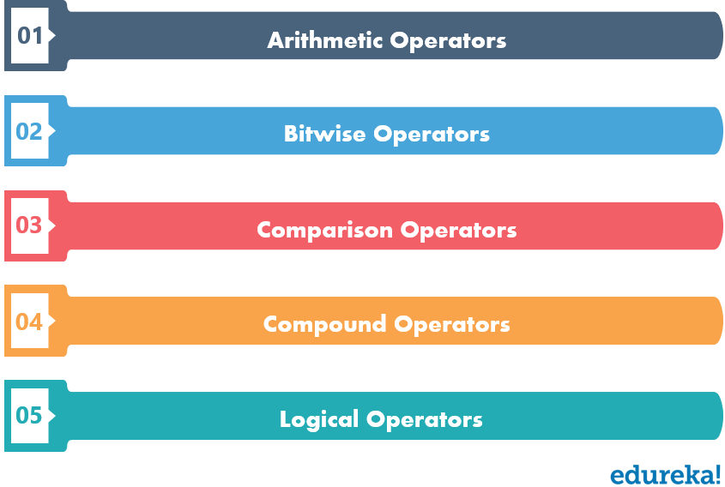
OPERATORS in SQL

Slide 33
Arithmetic Operators
Bitwise Operators
Arithmetic Operators
Operator | Description
% | Modulous [A % B]
/ | Division [A / B]
* | Multiplication [A * B]
– | Subtraction [A – B]
+ | Addition [A + B]
Bitwise Operators
Operator | Description
^ | Bitwise Exclusive OR (XOR) [A ^ B]
| | Bitwise OR [A | B]
& | Bitwise AND [A & B]

Slide 34
Comparison Operators
Compound Operators
Compound Operators
Operator | Description
|*= | Bitwise OR equals [A |*= B]
^-= | Bitwise Exclusive equals [A ^-= B]
&= | Bitwise AND equals [A &= B]
%= | Modulo equals [A %= B]
/= | Divide equals [A /= B]
*= | Multiply equals [A*= B]
-= | Subtract equals [A-= B]
+= | Add equals [A+= B]

Slide 35
Comparison Operators
Operator | Description
< > | Not Equal to [A < > B]
<= | Less than or equal to [A <= B]
>= | Greater than or equal to [A >= B]
< | Less than [A < B]
> | Greater than [A > B]
= | Equal to [A = B]

Slide 36
Logical Operators
The Logical operators present in SQL are as follows:
AND
OR
NOT
BETWEEN
LIKE
IN
EXISTS
ALL
ANY

Slide 37
Logical Operators
AND Operator
Example
SELECT * FROM Employee_Info WHERE City='Mumbai' AND City='Hyderabad';
OR Operator
Example
SELECT * FROM Employee_Info WHERE City='Mumbai' OR City='Hyderabad';
NOT Operator
Example
SELECT * FROM Employee_Info WHERE NOT City='Mumbai';

Slide 38
Logical Operators
You can also combine the above three operators and write a query
as follows:
SELECT * FROM Employee_Info WHERE NOT Country='India' AND
(City='Bangalore' OR City='Hyderabad');
NOTE: You can also combine the above three operators and write a
query as follows:
SELECT * FROM Employee_Info WHERE NOT Country='India'
AND (City='Bangalore' OR City='Hyderabad');

Slide 39
Logical Operators
BETWEEN Operator
The BETWEEN operator is used, when you want to select values within a given range.
Syntax
SELECT ColumnName(s) FROM TableName WHERE ColumnName BETWEEN Value1 AND Value2;
Example
SELECT * FROM Employee_Salary
WHERE Salary BETWEEN 40000 AND 50000;

Slide 40
Logical Operators
Like Operator Condition | Description
WHERE CustomerName LIKE ‘v% | Finds any values that start with “v”
WHERE CustomerName LIKE ‘%v’ | Finds any values that end with “v”
WHERE CustomerName LIKE ‘%and%’ | Finds any values that have “and” in any position
WHERE CustomerName LIKE ‘_q%’ | Finds any values that have “q” in the second position.
WHERE CustomerName LIKE ‘u_%_%’ | Finds any values that start with “u” and are at least 3 characters in length
WHERE ContactName LIKE ‘m%a’ | Finds any values that start with “m” and end with “a”
SELECT * FROM Employee_Info WHERE EmployeeName LIKE 'S%';

Slide 41
Logical Operators
LIKE Operator
The LIKE operator is used in a WHERE clause to search for a specified pattern in a column of a table.
There are mainly two wildcards that are used in conjunction with the LIKE operator:
% – It matches 0 or more character.
_ – It matches exactly one character.
Syntax
SELECT ColumnName(s) FROM TableName WHERE ColumnName LIKE pattern

Slide 42
IN Operator
This operator is used for multiple OR conditions. This allows you to specify multiple values in a WHERE clause.
Example
SELECT * FROM Employee_Info WHERE City IN ('Mumbai', 'Bangalore', 'Hyderabad');
EXISTS Operator
Example
SELECT EmergencyContactName FROM Employee_Info
WHERE EXISTS (SELECT EmergencyContactName FROM Employee_Info WHERE EmployeeId = 05 AND City = 'Kolkata');

Slide 43
ALL Operator
The ALL operator is used with a WHERE or HAVING clause and returns TRUE if all of the subquery values meet the condition.
Syntax
SELECT EmployeeName FROM Employee_Info
WHERE EmployeeID = ALL (SELECT EmployeeID FROM Employee_Info WHERE City = Hyderabad');

Slide 44
Aggregate Functions
This section of the article will include the following functions:
MIN()
MAX()
COUNT()
SUM()
AVG()

Slide 45
Aggregate Functions
MIN() Function
The MIN function returns the smallest value of the selected column in a table.
Example
SELECT MIN(EmployeeID) AS SmallestID FROM Employee_Info;
MAX() Function
SELECT MAX(Salary) AS LargestFees FROM Employee_Salary;

Slide 46
Aggregate Functions
COUNT() Function
Example
SELECT COUNT(EmployeeID) FROM Employee_Info;
SUM() Function
Example2
SELECT SUM(Salary) FROM Employee_Salary;
AVG() Function
Example
SELECT AVG(Salary) FROM Employee_Salary;
NULL Functions
SELECT EmployeeID * (Month_Year_of_Salary + ISNULL(Salary, 0))
FROM Employee_Salary;

Slide 47
SQL Commands: Nested Queries
Nested queries are those queries which have an outer query and inner subquery.
So, basically, the subquery is a query which is nested within another query such as SELECT, INSERT, UPDATE or DELETE.

Slide 48
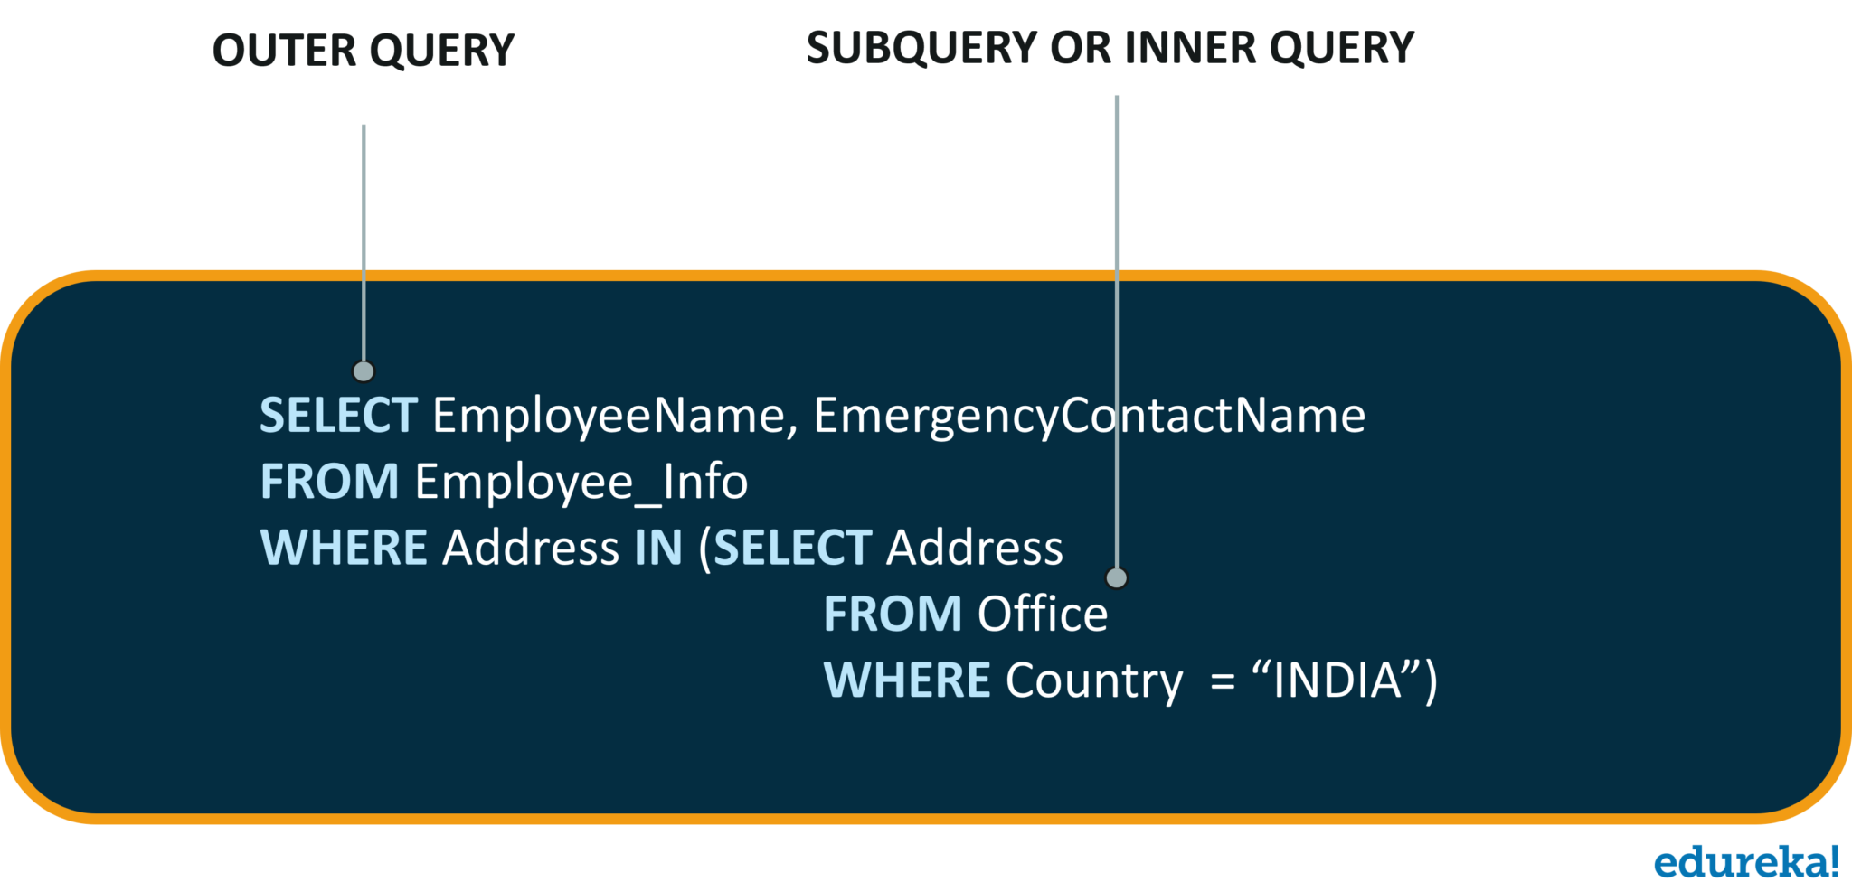
SQL Commands: Nested Queries

Slide 49
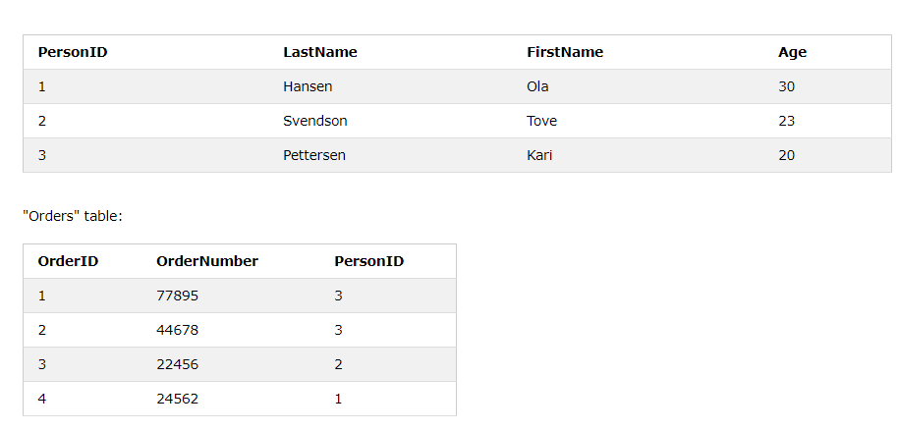

Slide 50
Notice that the "PersonID" column in the "Orders" table points to the "PersonID" column in the "Persons" table.
The "PersonID" column in the "Persons" table is the PRIMARY KEY in the "Persons" table.
The "PersonID" column in the "Orders" table is a FOREIGN KEY in the "Orders" table.
The FOREIGN KEY constraint is used to prevent actions that would destroy links between tables.
The FOREIGN KEY constraint also prevents invalid data from being inserted into the foreign key column, because it has to be one of the values contained in the table it points to.

Slide 51
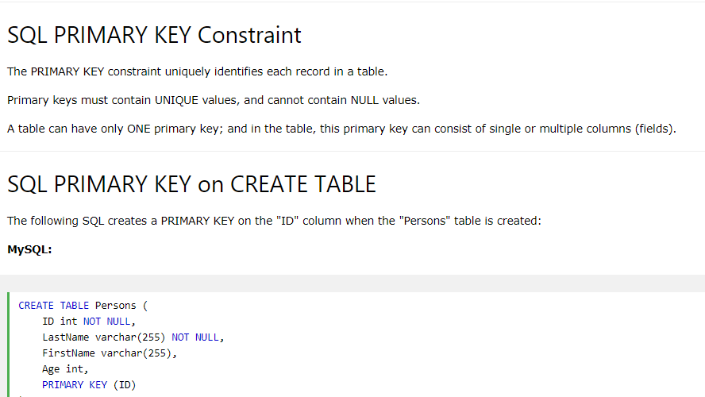

Slide 52
CREATE TABLE Persons ( ID int NOT NULL PRIMARY KEY, LastName varchar(255) NOT NULL, FirstName varchar(255), Age int);

Slide 53
CREATE TABLE Persons ( ID int NOT NULL, LastName varchar(255) NOT NULL, FirstName varchar(255), Age int, CONSTRAINT PK_Person PRIMARY KEY
(ID,LastName);

Slide 54
ALTER TABLE Persons ADD PRIMARY KEY (ID);
ALTER TABLE Persons DROP PRIMARY KEY;
ALTER TABLE Persons DROP CONSTRAINT PK_Person;

Slide 55
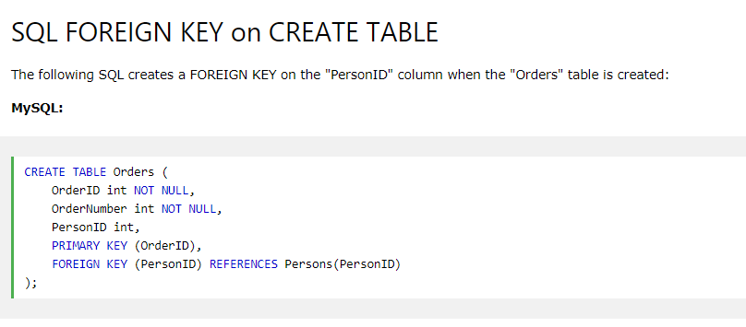

Slide 56
CREATE TABLE Orders ( OrderID int NOT NULL, OrderNumber int NOT NULL, PersonID int, PRIMARY KEY (OrderID), CONSTRAINT FK_PersonOrder FOREIGN KEY (PersonID) REFERENCES Persons(PersonID) );

Slide 57
ALTER TABLE Orders ADD FOREIGN KEY (PersonID) REFERENCES Persons(PersonID);
ALTER TABLE Orders ADD CONSTRAINT FK_PersonOrder FOREIGN KEY (PersonID) REFERENCES Persons(PersonID);

Slide 58
ALTER TABLE Orders DROP FOREIGN KEY FK_PersonOrder;
ALTER TABLE Orders DROP CONSTRAINT FK_PersonOrder;

Slide 59
SQL Date Data Types
MySQL comes with the following data types for storing a date or a date/time value in the database:
DATE - format YYYY-MM-DD
DATETIME - format: YYYY-MM-DD HH:MI:SS
TIMESTAMP - format: YYYY-MM-DD HH:MI:SS
YEAR - format YYYY or YY

Slide 60
SELECT * FROM Orders WHERE OrderDate='2008-11-11'

Slide 61
SQL CREATE VIEW Examples
CREATE VIEW [Brazil Customers] AS SELECT CustomerName, ContactName FROM Customers WHERE Country = 'Brazil';
CREATE VIEW [Products Above Average Price] AS SELECT ProductName, Price FROM Products WHERE Price > (SELECT AVG(Price) FROM Products);

Slide 62
CREATE OR REPLACE VIEW view_name AS SELECT column1, column2, ... FROM table_name WHERE condition;
CREATE OR REPLACE VIEW [Brazil Customers] AS SELECT CustomerName, ContactName, City FROM Customers WHERE Country = 'Brazil';
DROP VIEW view_name;

Slide 63
Embedded SQL
Applications are developed using some general purpose languages like C, C++, JAVA, etc. These languages are used to get UIs, forms etc.
SQLs inside the application language like C, C++, Java etc, and make these applications to communicate with DB.

Slide 64
Structure of Embedded SQL
Structure of embedded SQL defines step by step process of establishing a connection with DB and executing the code in the DB within the high level language

Slide 65
Structure of Embedded SQL
Connection to DB
This is the first step while writing a query in high level languages.
First connection to the DB that we are accessing needs to be established. This can be done using the keyword CONNECT. But it has to precede with
‘EXEC SQL’ to indicate that it is a SQL statement.
EXEC SQL CONNECT db_name;
EXEC SQL CONNECT HR_USER; //connects to DB HR_USER

Slide 66
Structure of Embedded SQL
Declaration Section
Once connection is established with DB, we can perform DB transactions. Since these DB transactions are dependent on the values and variables of the host language.
Depending on their values, query will be written and executed.
Similarly, results of DB query will be returned to the host language which will be captured by the variables of host language.
Hence we need to declare the variables to pass the value to the query and get the values from query. There are two types of variables used in the host language

Slide 67
Structure of Embedded SQL
Host Variable :
These are the variables of host language used to pass the value to the query as well as to capture the values returned by the query.
Since SQL is dependent on host language
We have to use variables of host language and such variables are known as host variable. But these host variables should be declared within the SQL area or within SQL code.
That means compiler should be able to differentiate it from normal C variables.
Hence we have to declare host variables within
BEGIN DECLARE and END DECLARE section.
Again, these declare block should be enclosed within EXEC SQL
and ‘;’.

Slide 68
Host Variable :
EXEC SQL BEGIN DECLARE SECTION;
int STD_ID;
char STD_NAME [15];
char ADDRESS[20];
EXEC SQL END DECLARE SECTION

Slide 69
Host Variable :
We can note here that variables are written inside begin and end block of the SQL, but they are declared using C code.
It does not use SQL code to declare the variables. Why?
This is because they are host variables C language.
Hence we cannot use SQL syntax to declare them. Host language supports almost all the data types from int, char, long, float, double, pointer, array, string, structures etc

Slide 70
Host Variable :
When host variables are used in a SQL query, it should be preceded by colon – ‘:’ to indicate that it is a host variable.
Hence when pre-compiler compiles SQL code, it substitutes the value of host variable and compiles.
EXEC SQL SELECT * FROM STUDENT WHERE STUDENT_ID =:STD_ID;
In above code, :STD_ID will be replaced by its value when pre-compiler compiles it.
Suppose we do not know what should be the datatype of host variables or what is the datatype in oracle for few of the columns.
In such case we can allow the compiler to fetch the datatype of column and assign it to the host variable. It is done using ‘BASED ON’ clause. But format of declaration will be in host language.

Slide 71
Host Variable :
EXEC SQL BEGIN DECLARE SECTION;
BASED ON STUDENT.STD_ID sid;
BASED ON STUDENT.STD_NAME sname;
BASED ON STUDENT.ADDRESS saddress;
EXEC SQL END DECLARE SECTION;

Slide 72
Execution Section This is the execution section, and it contains all the
SQL queries and statements prefixed by ‘EXEC SQL’
EXEC SQL SELECT * FROM STUDENT WHERE STUDENT_ID =:STD_ID;
EXEC SQL SELECT STD_NAME INTO :SNAME :IND_SNAME
FROM STUDENT WHERE STUDENT_ID =:STD_ID;
INSERT INTO STUDENT (STD_ID, STD_NAME) VALUES (:SID, :SNAME);
UPDATE STUDENT SET ADDRESS = :STD_ADDR
WHERE STD_ID = :SID;

Slide 73
Consider a simple Pro*C program to illustrate embedded SQL. This program below accepts student name from the user and queries DB for his student i
#include <stdio.h>
#include <sqlca.h>
int main(){
EXEC SQL INCLUDE SQLCA;
EXEC SQL BEGIN DECLARE SECTION;
BASED ON STUDENT.STD_ID SID; // host variable to store the value returned by query
char *STD_NAME; // host variable to pass the value to the query
short ind_sid;// indicator variable
EXEC SQL END DECLARE SECTION;
//Error handling
EXEC WHENEVER NOT FOUND GOTO error_msg1;
EXEC WHENEVER SQLERROR GOTO error_msg2;
printf("Enter the Student name:");
scanf("%s", STD_Name)

Slide 74
// Executes the query
EXEC SQL SELECT STD_ID INTO : SID INDICATOR ind_sid FROM STUDENT WHERE STD_NAME = : STD_NAME;
printf("STUDENT ID:%d", STD_ID); // prints the result from DB
exit(0);
// Error handling labels
error_msg1:
printf("Student Id %d is not found", STD_ID);
printf("ERROR:%ld", sqlca->sqlcode);
printf("ERROR State:%s", sqlca->sqlstate);
exit(0);
error_msg2:
printf("Error has occurred!");
printf("ERROR:%ld", sqlca->sqlcode);
printf("ERROR State:%s", sqlca->sqlstate);
exit(0);

Slide 75
Embedding SQL in C: An Example
char SQLSTATE[6];
EXEC SQL BEGIN DECLARE SECTION
char c_sname[20]; short c_minrating; float c_age;
EXEC SQL END DECLARE SECTION
c_minrating = random();
EXEC SQL DECLARE sinfo CURSOR FOR
SELECT S.sname, S.age FROM Sailors S
WHERE S.rating > :c_minrating
ORDER BY S.sname;
do {
EXEC SQL FETCH sinfo INTO :c_sname, :c_age;
printf(“%s is %d years old\n”, c_sname, c_age);
} while (SQLSTATE != ‘02000’);
EXEC SQL CLOSE sinfo;

Slide 76
MySQL Fundamentals
.
MySQL is free.
Very widely used.
Implements SQL database mangement.
Linux Red Hat already includes MySQL.
Facebook uses MySQL.

Slide 77
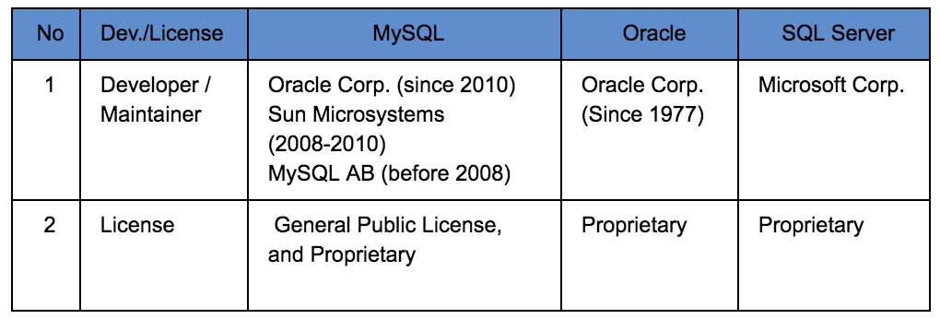

Slide 78
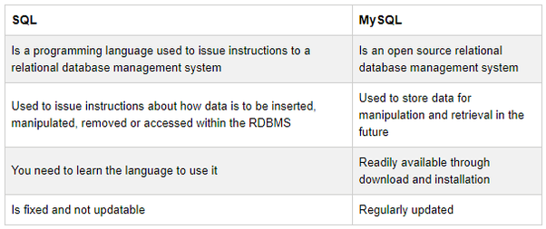

Slide 79
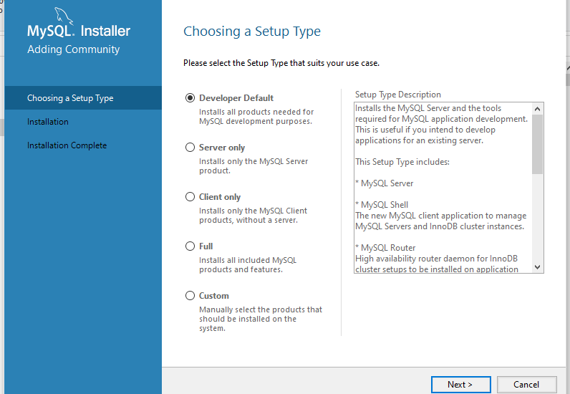

Slide 80
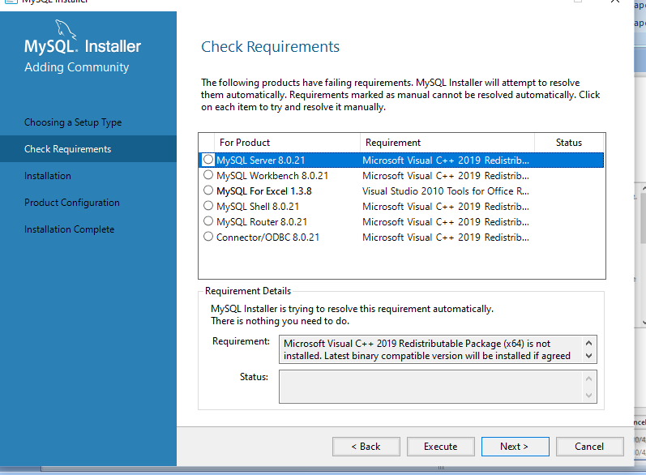

Slide 81
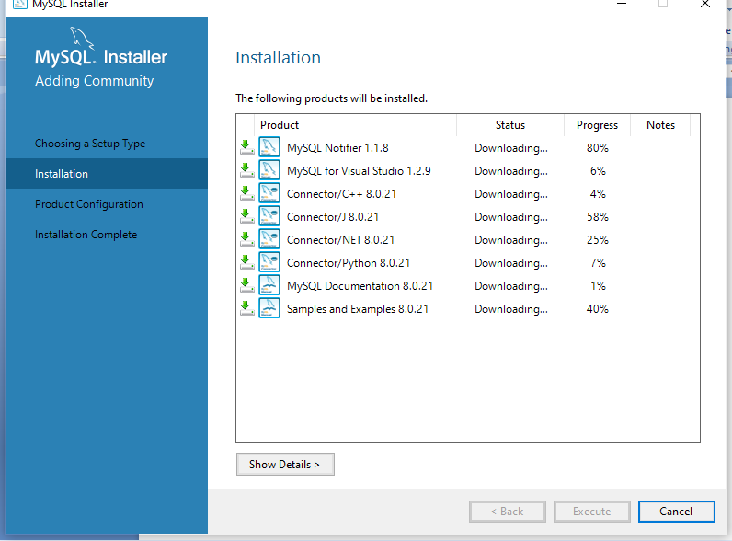

Slide 82
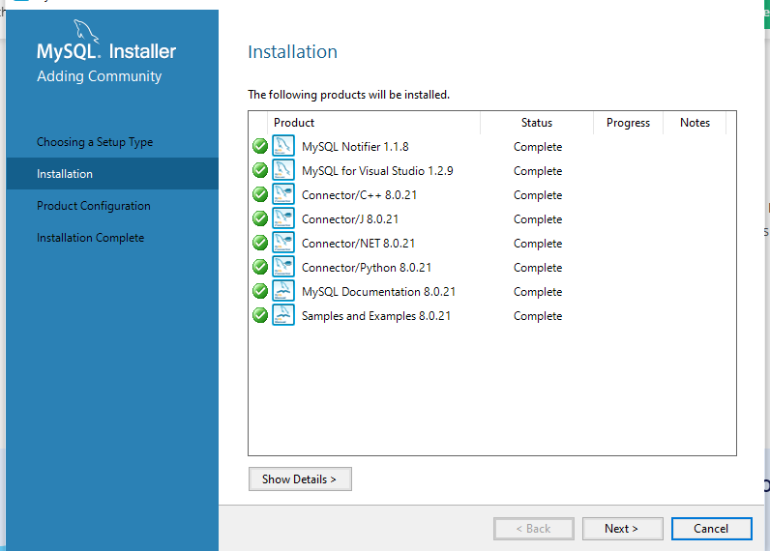

Slide 83
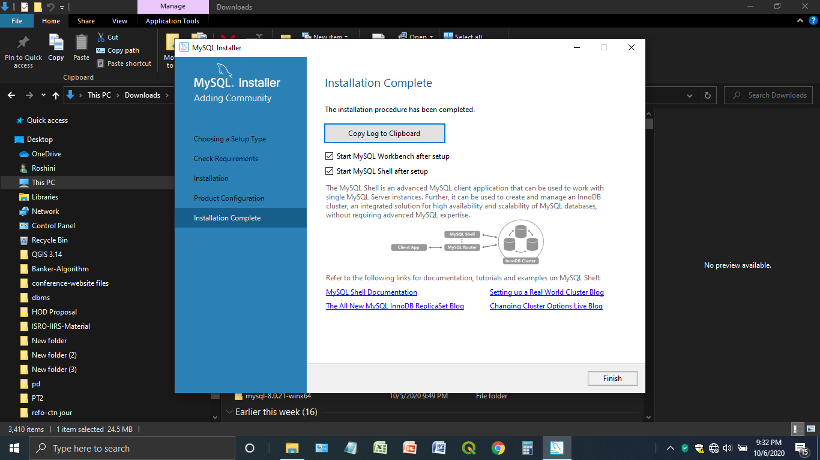

Slide 84
What is MySQL?
MySQL is currently the most popular database management system software used for managing the relational database.
It is open-source database software, which is supported by Oracle Company.
It is fast, scalable, and easy to use database management system in comparison with Microsoft SQL Server and Oracle Database.
It is commonly used in conjunction with PHP scripts for creating powerful and dynamic server-side or web-based enterprise applications.
MySQL supports many Operating Systems like Windows, Linux, MacOS, etc. with C, C++, and Java languages.

Slide 85
How MySQL Works?
MySQL follows the working of Client-Server Architecture.
This model is designed for the end-users called clients to access the resources from a central computer known as a server using network services.
Here, the clients make requests through a graphical user interface (GUI), and the server will give the desired output as soon as the instructions are matched.
The process of MySQL environment is the same as the client-server model.

Slide 86
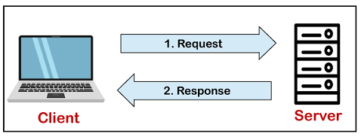
How MySQL Works?

Slide 87
MySQL Features
Relational Database Management System (RDBMS)
Easy to use
It is secure
Free to download
It is scalable. It can handle almost any amount of data, up to as much as 50 million rows or more.
Speed
High Flexibility. MySQL supports a large number of embedded applications, which makes MySQL very flexible.
Compatible on many operating systems
Memory efficiency
GUI Support

Slide 88
Disadvantages/Drawback of MySQL
MySQL version less than 5.0 doesn't support ROLE, COMMIT, and stored procedure.
MySQL does not support a very large database size as efficiently.
MySQL doesn't handle transactions very efficiently, and it is prone to data corruption.
MySQL is accused that it doesn't have a good developing and debugging tool compared to paid databases.
MySQL doesn't support SQL check constraints.

Slide 89
MySQL Data Types
MySQL Data Types

Slide 90
MySQL Create User
CREATE USER [IF NOT EXISTS] account_name
IDENTIFIED BY 'password';
mysql> select user from mysql.user;
mysql> create user peter@localhost identified by 'jtp12345';
mysql> CREATE USER IF NOT EXISTS adam@localhost IDENTIFIED BY 'jtp123456';

Slide 91
Grant Privileges to the MySQL New User
MySQL server provides multiple types of privileges to a new user account. Some of the most commonly used privileges are given below:
ALL PRIVILEGES: It permits all privileges to a new user account.
CREATE: It enables the user account to create databases and tables.
DROP: It enables the user account to drop databases and tables.
DELETE: It enables the user account to delete rows from a specific table.
INSERT: It enables the user account to insert rows into a specific table.
SELECT: It enables the user account to read a database.
UPDATE: It enables the user account to update table rows.

Slide 92
Grant Privileges to the MySQL New User
mysql> GRANT ALL PRIVILEGES ON * . * TO
peter@localhost;
mysql> GRANT CREATE, SELECT, INSERT ON * . * TO peter@localhost;
mysql> Select user(); or,
mysql> Select current_user();
mysql> UPDATE user SET password = PASSWORD('jtp12345') WHERE user = 'peter' AND host = 'localhost';
DROP USER 'account_name';
DROP USER martin@localhost;
DROP USER john@localhost, peter@localhost;

Slide 93
MySQL Create Database
MySQL implements a database as a directory that stores all files in the form of a table. It allows us to create a database mainly in two ways:
MySQL Command Line Client
MySQL Workbench

Slide 94
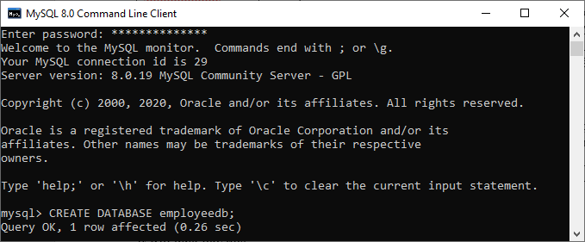
MySQL Command Line

Slide 95
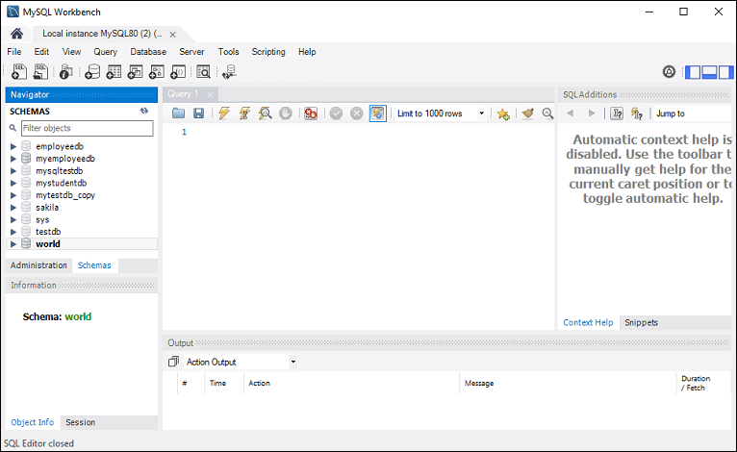
MySQL Workbench
Create Database

Slide 96
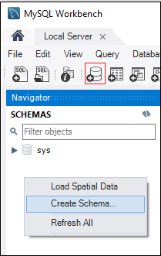
MySQL Workbench Create Database

Slide 97
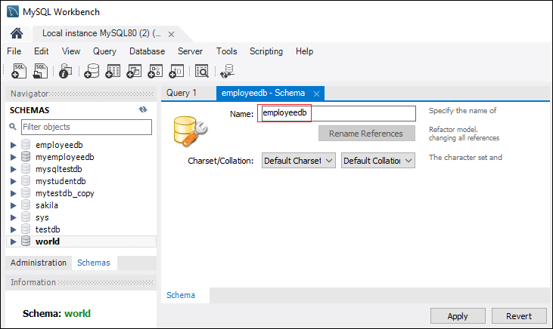
MySQL Workbench Create Database

Slide 98
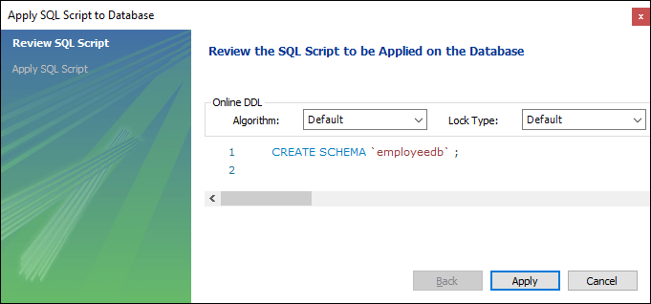
MySQL Workbench Create Database

Slide 99
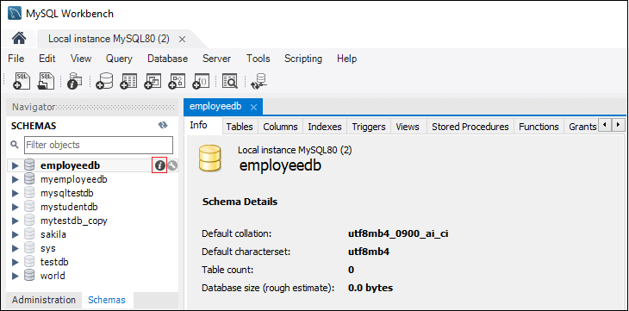
MySQL Workbench Create Database

Slide 100
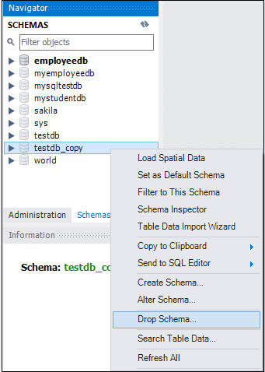

Slide 101
mysql> USE database_name;
mysql> CREATE TABLE employee_table(
id int NOT NULL AUTO_INCREMENT,
name varchar(45) NOT NULL,
occupation varchar(35) NOT NULL,
age int NOT NULL,
PRIMARY KEY (id)

Slide 102
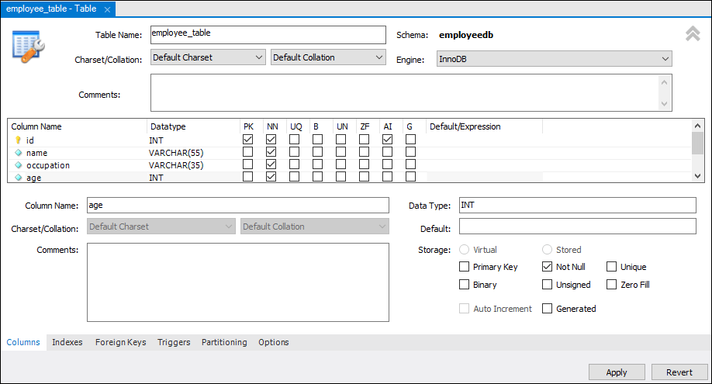

Slide 103
insert into customers values(101,'rahul','delhi');
update customers set name='bob', city='london' where id=101;
delete from customers where id=101;
truncate table customers;

Slide 104
Constraints used in MySQL
NOT NULL
CHECK
DEFAULT
PRIMARY KEY
AUTO_INCREMENT
UNIQUE- no duplicate values
INDEX
ENUM
FOREIGN KEY

Slide 105
mysql> CREATE TABLE Persons (
ID int NOT NULL,
Name varchar(45) NOT NULL,
Age int CHECK (Age>=18));
mysql> CREATE TABLE Persons (
ID int NOT NULL,
Name varchar(45) NOT NULL,
Age int,
City varchar(25) DEFAULT 'New York‘ );

Slide 106
mysql> CREATE TABLE Shirts (
id INT PRIMARY KEY AUTO_INCREMENT,
name VARCHAR(35),
size ENUM('small', 'medium', 'large', 'x-large‘)
);

Slide 107
Mysql>SELECT Name, City, SUM(working_hours) AS "Total working hours"
FROM employee_detail
GROUP BY Name
HAVING SUM(working_hours) > 5;
Mysql>SELECT cust_name, city, order_num, order_date
FROM customer INNER JOIN orders
ON customer.cust_id = orders.order_id
WHERE order_date < '2020-04-30'
ORDER BY cust_name;

Slide 108
mysql> SELECT MAX(income) AS "Maximum
Income" FROM employees;
mysql> SELECT MAX(income) AS "Maximum Income" FROM employees
WHERE emp_age > 35;
mysql> SELECT emp_age, MAX(income) AS
"Maximum Income" FROM employees
GROUP BY emp_age;

Slide 109
mysql> SELECT city, MAX(income) AS "Maximum Income“ FROM employees
GROUP BY city
HAVING MAX(income) >= 200000;
mysql> SELECT city, MAX(DISTINCT income) AS
"Maximum Income" FROM employees
GROUP BY city;
mysql> SELECT * FROM employees WHERE
emp_age = (SELECT MAX(emp_age) FROM employees);

Slide 110
mysql> SELECT AVG(working_hours) Avg_working_hours FROM employees;
mysql> SELECT AVG(working_hours) Avg_working_hours FROM employees WHERE working_hours>=12;
mysql> SELECT emp_name, occupation, AVG(working_hours) Avg_working_hours FROM employees GROUP BY occupation;

Slide 111
mysql> SELECT emp_name, occupation,
AVG(working_hours) Avg_working_hours
FROM employees
GROUP BY occupation
HAVING AVG(working_hours)>9;
mysql> SELECT emp_name, occupation,
AVG(DISTINCT working_hours) Avg_working_hours
FROM employees
GROUP BY occupation;

Slide 112
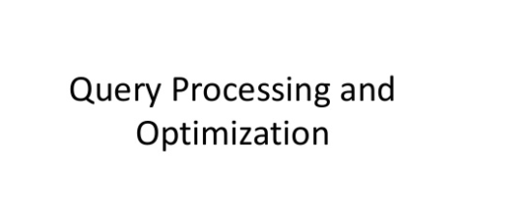

Slide 113
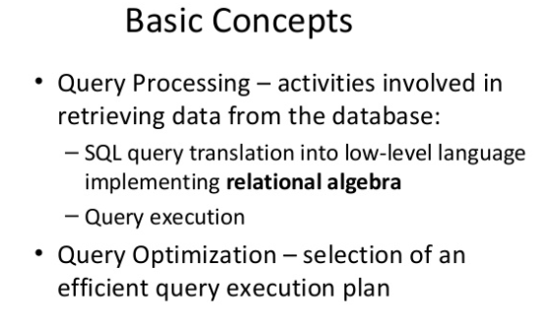
Query processing & optimization

Slide 114
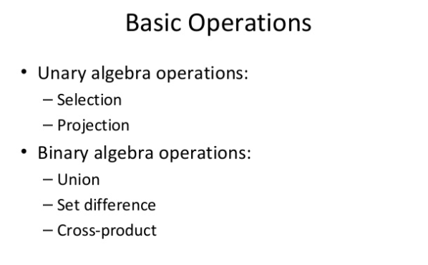
Relational algebra

Slide 115
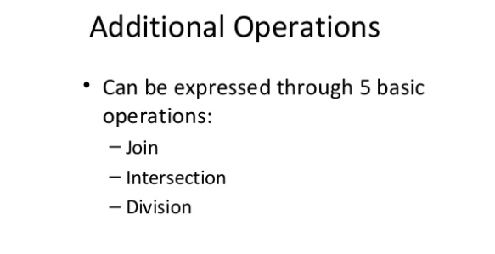
Relational algebra

Slide 116
Typical steps when processing a high level query.
The steps involved in processing a query appear The basic steps are:
1. Parsing and translation.
2. Optimization.
3. Evaluation.

Slide 117
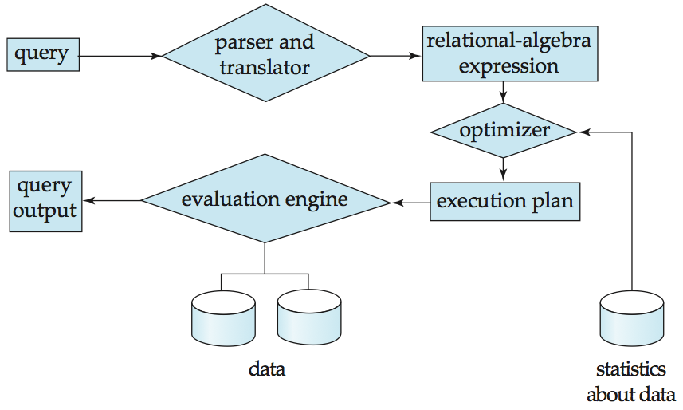
QUERY PROCESSING

Slide 118
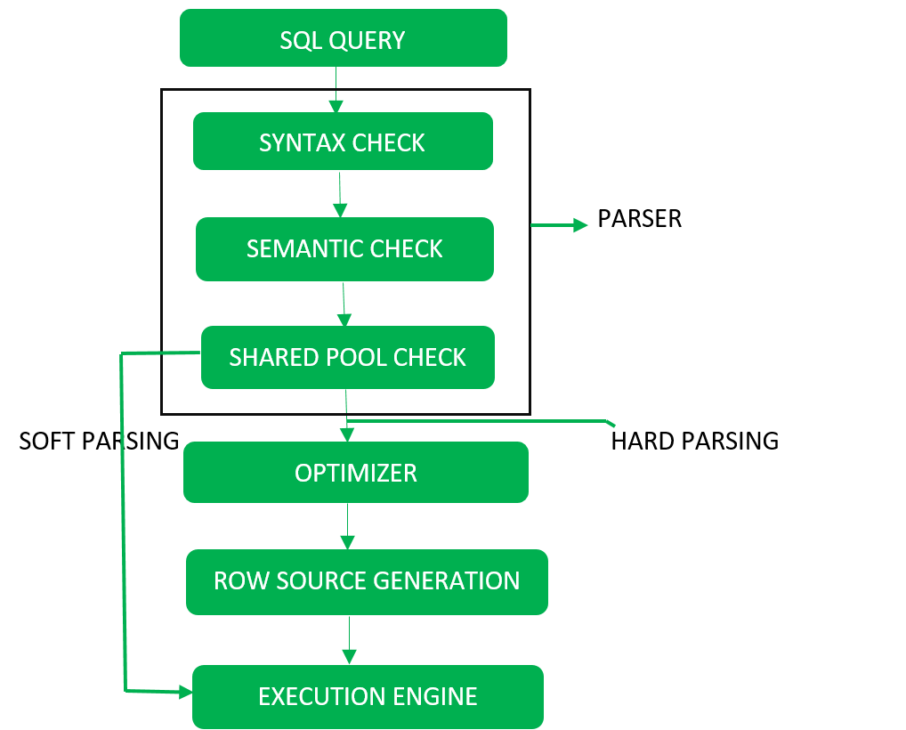

Slide 119
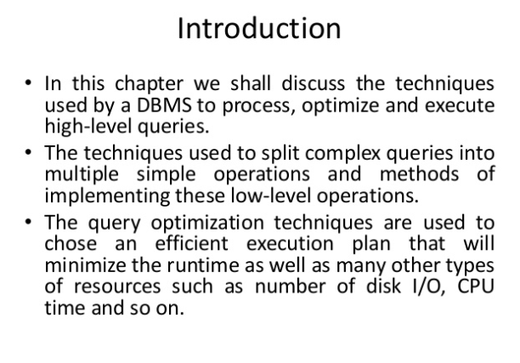
QUERY PROCESSING & OPTIMIZATION

Slide 120
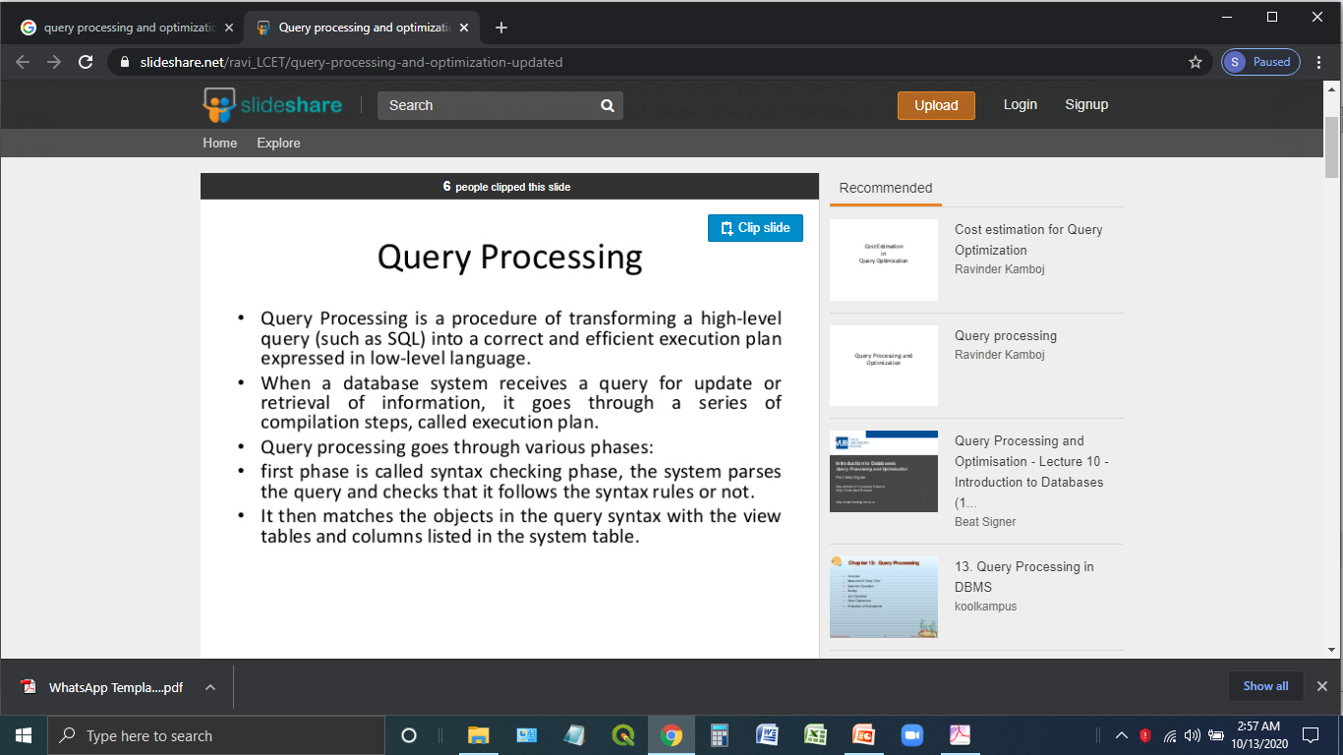

Slide 121
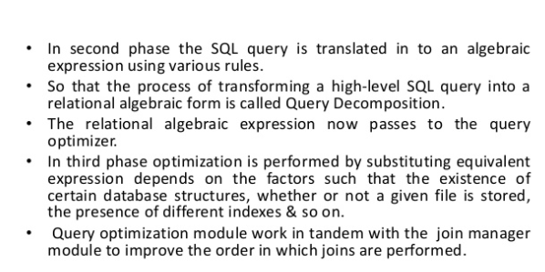

Slide 122
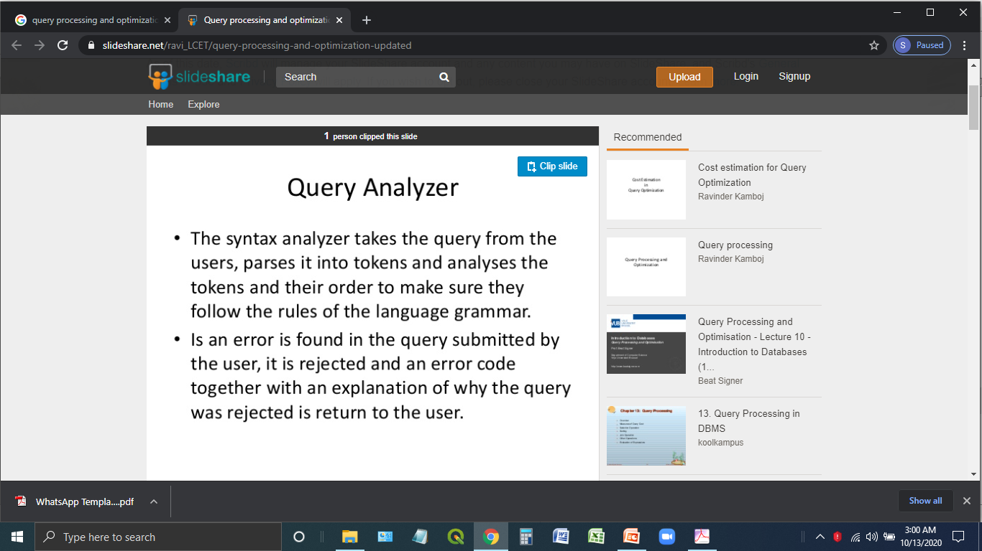

Slide 123
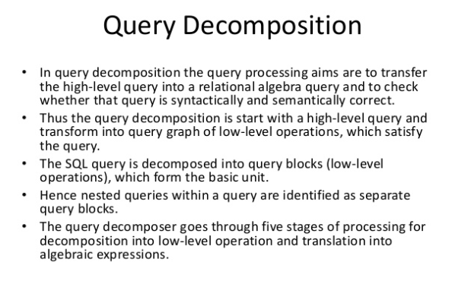

Slide 124
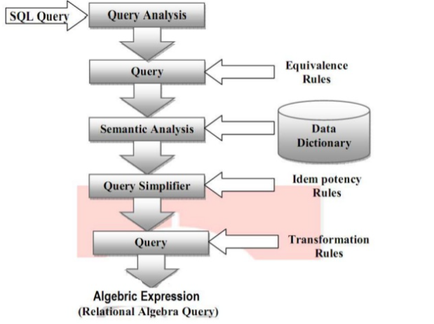

Slide 125
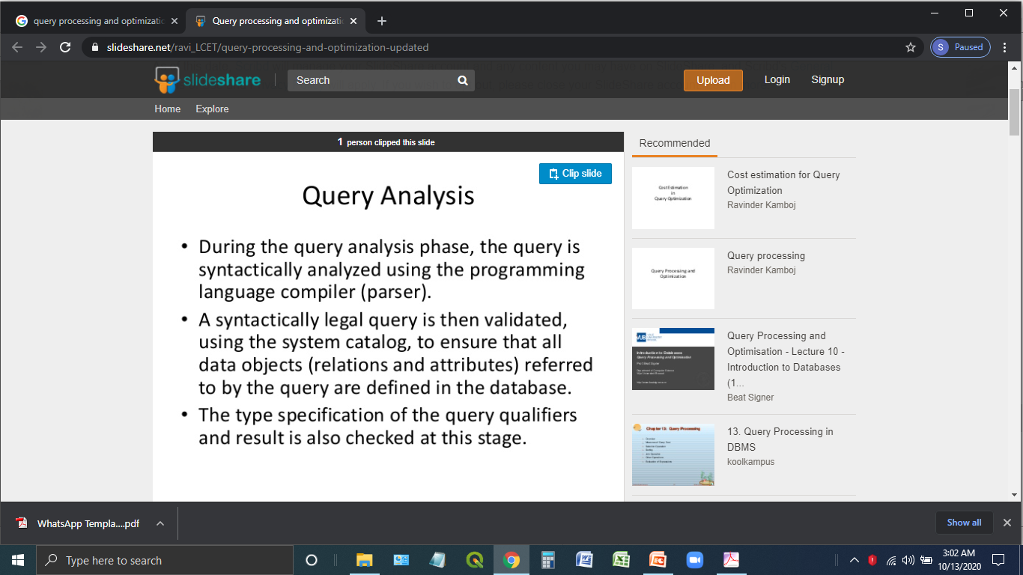

Slide 126
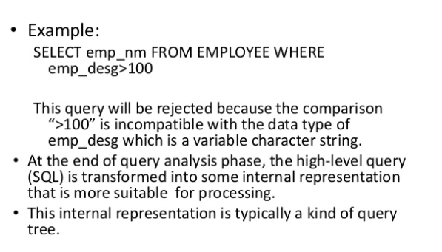
Query analysis

Slide 127
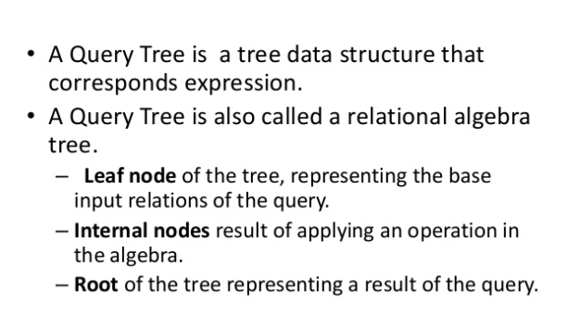
Query tree

Slide 128
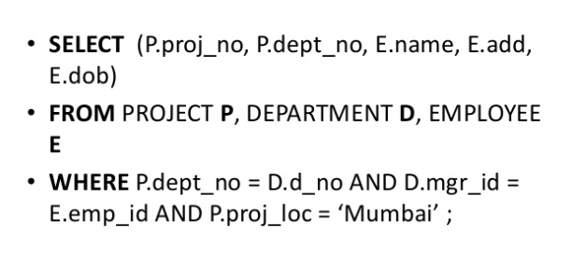
Query tree

Slide 129
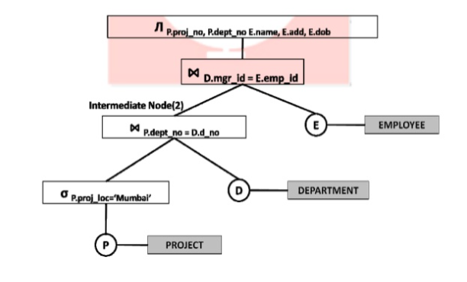
Query tree

Slide 130
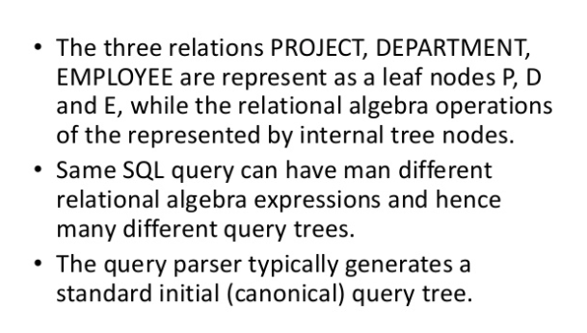
Query tree

Slide 131
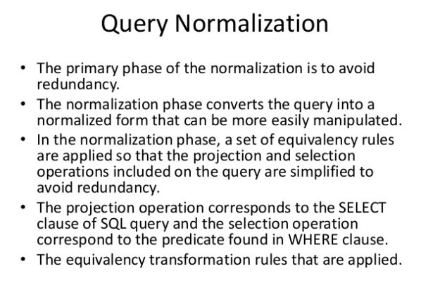

Slide 132
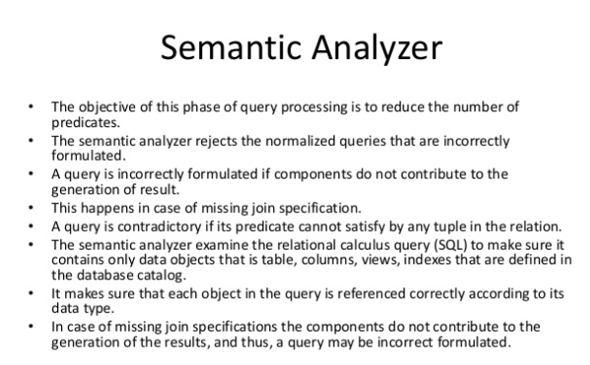

Slide 133


Slide 134
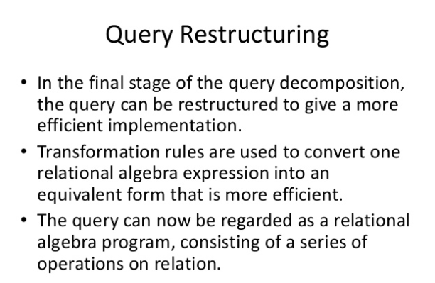

Slide 135
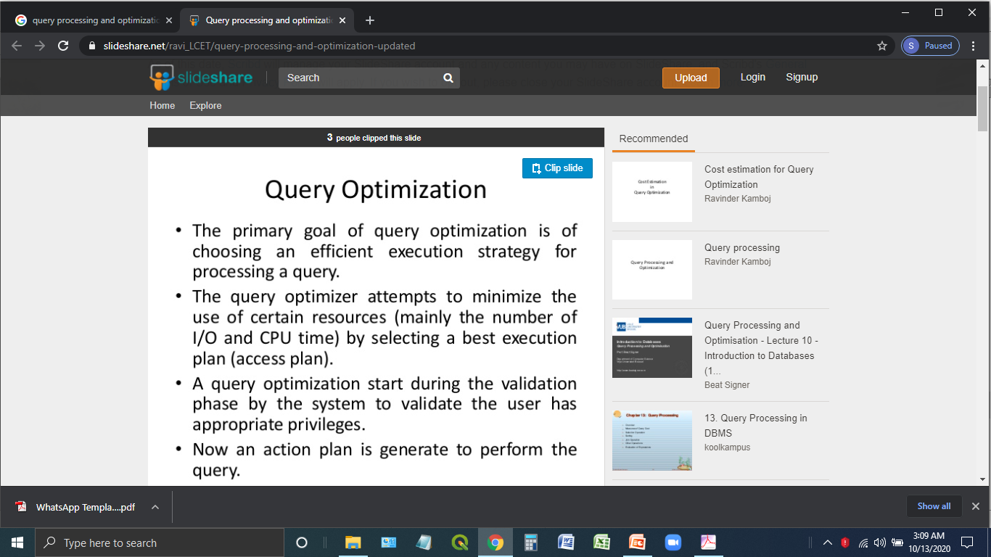

Slide 136
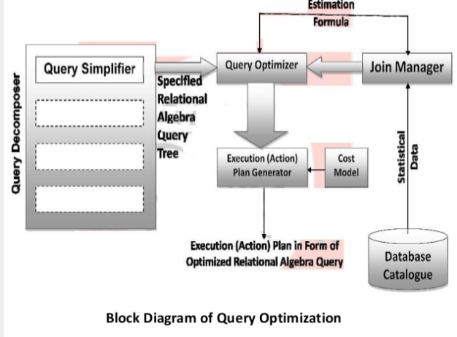

Slide 137
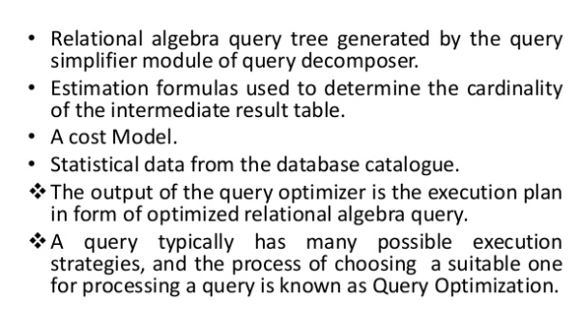

Slide 138
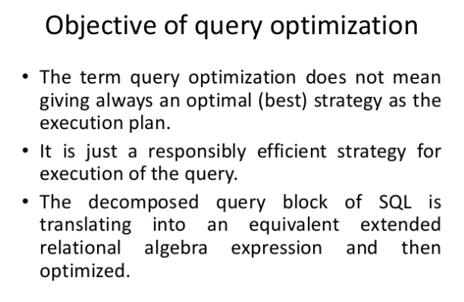

Slide 139
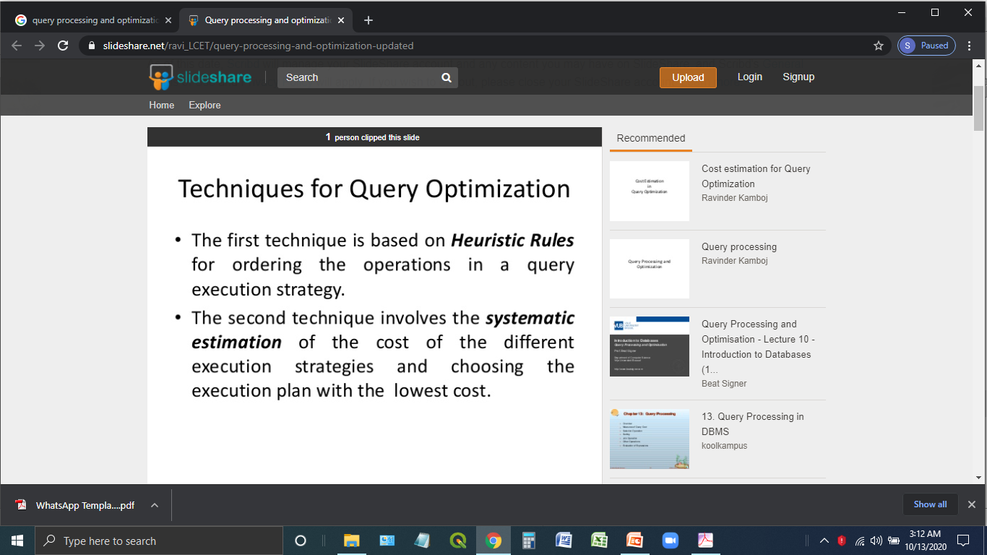

Slide 140
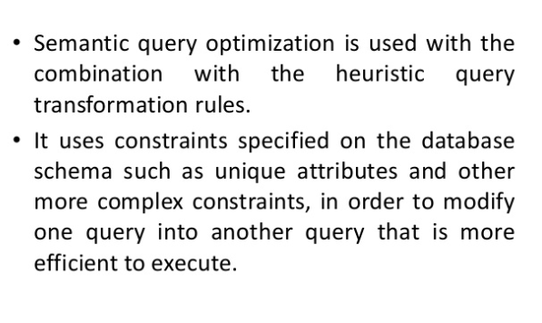

Slide 141
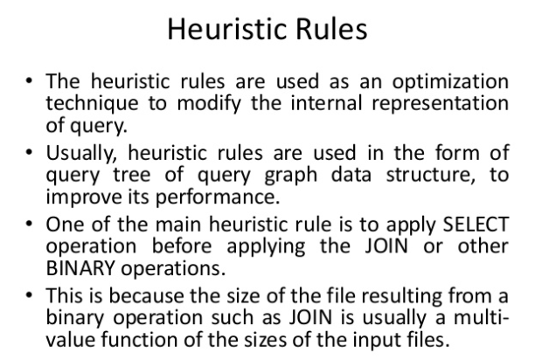

Slide 142


Slide 143


Slide 144


Slide 145


Slide 146


Slide 147


Slide 148


Slide 149


Slide 150


Slide 151


Slide 152


Slide 153


Slide 154


Slide 155


Slide 156


Slide 157


Slide 158


Slide 159


Slide 160


Slide 161


Slide 162


Slide 163


Slide 164


Slide 165


Slide 166


Slide 167


Slide 168


Slide 169


Slide 170


Slide 171


Slide 172


Slide 173


Slide 174


Slide 175


Slide 176


Slide 177


Slide 178


Slide 179


